Slide 1
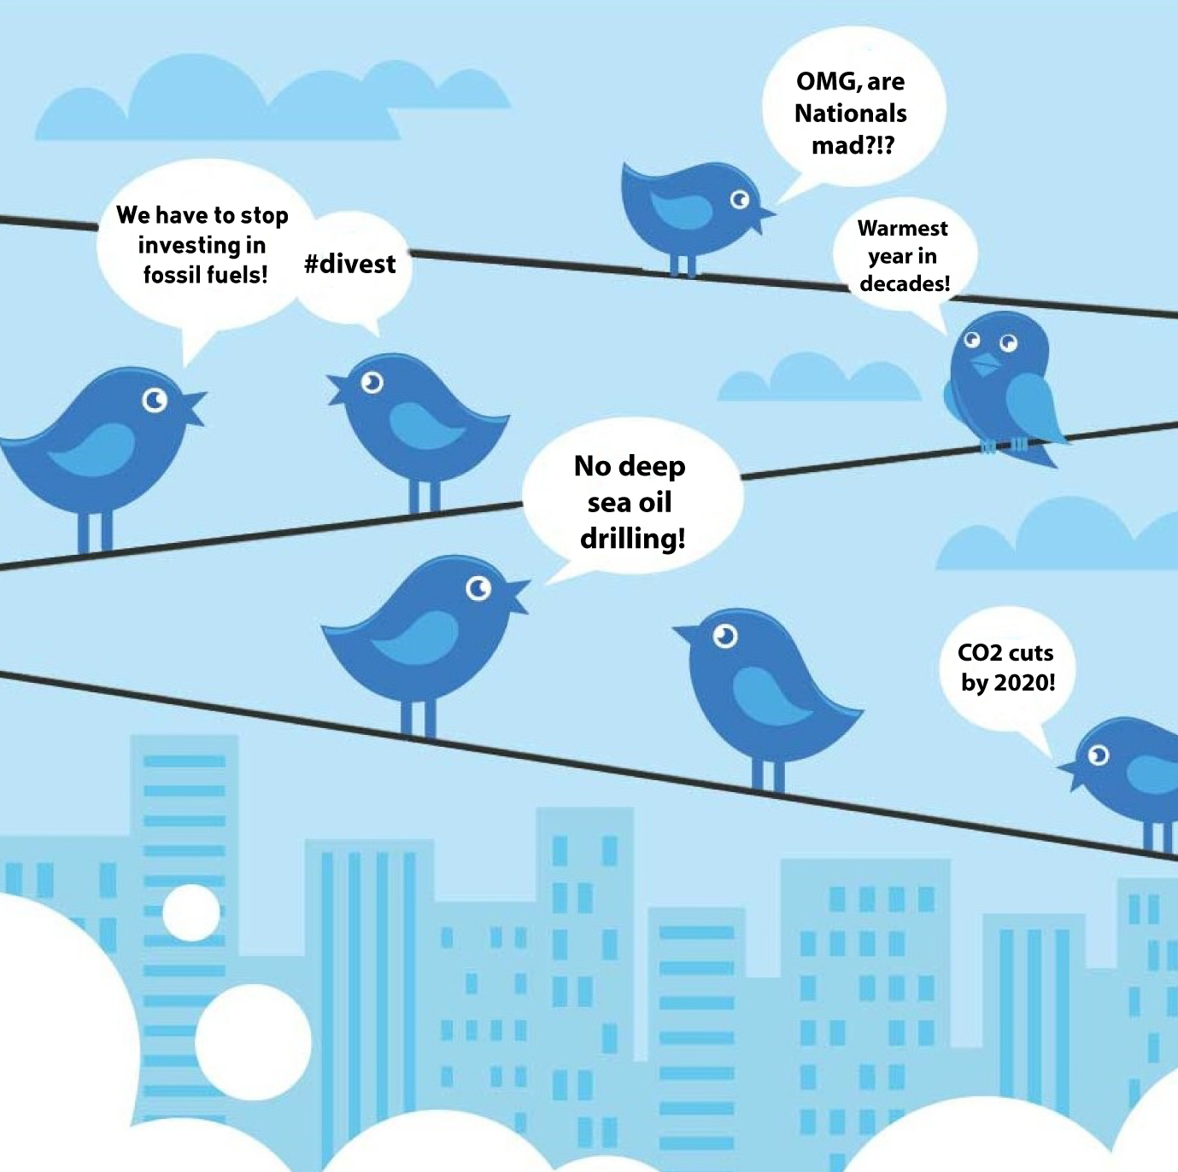
Climate Change Discourse on Twitter
Isabel Arvelo
Notes:
Hi, my name is Isa and I will be walking through a text analysis of tweets about climate change in 2022.
Climate change poses significant threats to our environment, health, and economies, with effects such as natural disasters, disease spread, and social tensions. Addressing it is both a moral responsibility to ensure justice and sustainability for vulnerable communities and future generations, and an opportunity for economic innovation in sustainable sectors. The decisions made today will shape the well-being, stability, and quality of life for all global inhabitants in the future.
With its vast and diverse user base, Twitter provides insights into a wide range of demographics, geographies, and perspectives on climate change and Influential figures, organizations, and policymakers often use Twitter to communicate their view and it has been a platform for mobilizing public action

Slide 2

Motivation
What are the main topics, themes, and narratives that dominate climate change discussions on Twitter? What does the discourse tend to focus on?
What individuals, organizations, locations, and other entities are most influential in shaping the climate change narrative on Twitter?
Notes:
Understanding the prevalent themes and narratives can help gauge public understanding and sentiment regarding climate change and help in spotting misinformation or biased perspectives.
Recognizing the key players and influencers in the climate change discourse can aid in collaboration, partnerships, and mobilization efforts for climate action.

Slide 3

Dataset Overview: Climate Change Tweets on Twitter
Source: Tweets scraped by Kaggle user Diego Farchione
Duration: Captured from January 2022 to July 2022.
Content: Highlights top tweets with the keyword 'Climate Change’ between January 2022 to July 2022.
Key Features (for each tweet):
User & Tweet Details:
User Screen Name, Username, Text, Date
Engagement Metrics :
Comments, Likes, and Retweets
Additional Context:
Emojis, Image Link
Notes:
My dataset is from Kaggle and includes 7 months of twitter data scraped by user Diego Farchione between January and July 2022. Each row in the dataset represents a tweet posted in the period and the columns represent information about the tweer including user & tweet details, engagement metrics and additional context

Slide 4
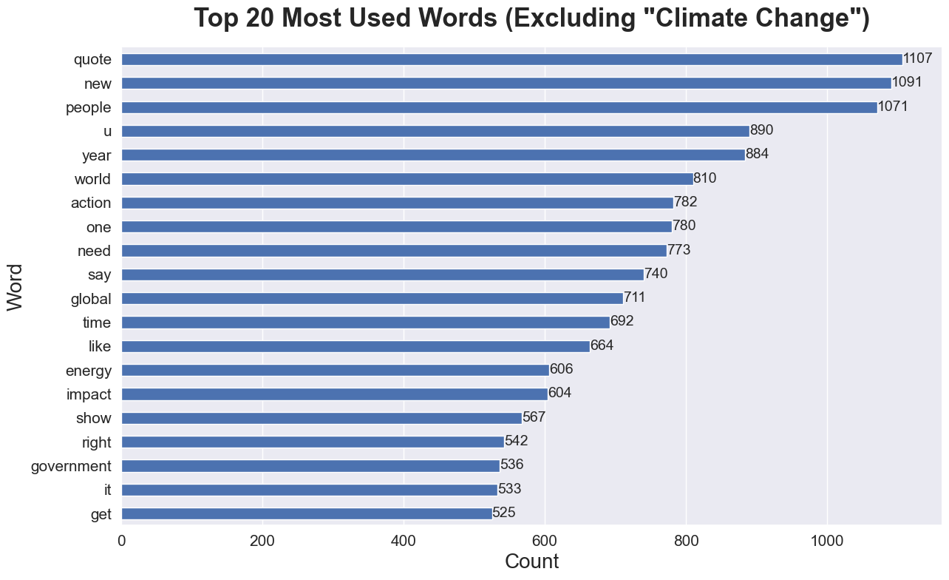
Analysis: Word Frequency
Referencing & Responsibility:
"quote," "people," and "world"
Urgency & Action:
"action," "need," and "crisis"
Topics & Solutions:
"energy," "impact," and "global"
Notes:
The y axis represents the top 20 most commonly used words excluding the words climate change and other common stopwords on twitter , with the most common term at the top the x axis represents the count or the number of times each word appears in the corpus of tweets. The numbers themselves aren’t as important as the relative frequency of words.
Referencing & Responsibility: High mentions of "quote," "people," and "world" show a trend of referencing others and emphasizing global responsibility.
Urgency & Action: Terms like "action," "need," and "crisis" highlight the immediacy and urgency in the climate change discourse.
Topics & Solutions: Words such as "energy," "impact," and "global" point to discussions on renewable solutions and global effects.
The term "quote" with 1107 mentions suggests a lot of the climate change conversation on Twitter involves referencing or discussing opinions and statements made by others. This could be experts, politicians, activists, or celebrities.
"People" and "world" with 1071 and 810 mentions respectively emphasize the collective and global nature of the issue. It indicates that the discussions are not about isolated incidents or regional concerns but have a global perspective.
Words indicating urgency like "action," "need," and "crisis" with 782, 773, and 500 mentions respectively, indicate that many tweets emphasize the pressing and immediate nature of the problem.
Specific topics like "energy" (606 mentions) suggest discussions might be centered around renewable energy sources, ways to reduce carbon footprint, and sustainable living.
"Impact" with 604 mentions can be related to discussions about the effects of climate change on the environment, wildlife, and human populations.
The term "global" with 711 mentions further cements the idea that the discussions are about the worldwide effects of climate change and not restricted to specific regions.

Slide 5
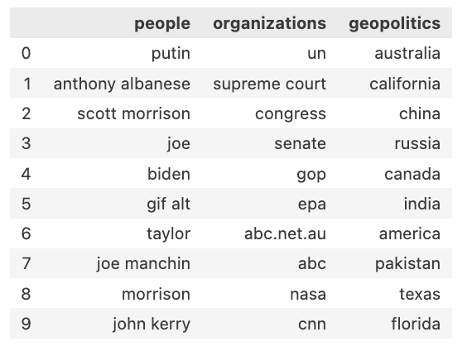
Analysis: Named Entity Recognition
Top Mentioned Entities in Tweets
Prominent Figures & Politics
Climate change conversation is intertwined with political decisions and leadership
Global Institutions & Media
Global policies, legal discussion, media outlets
Global Spread
Shared responsibility and concern across continents
Table 1: A summary of the most frequently mentioned people, organizations, and geopolitical entities in the analyzed tweets.
Notes:
Named Entity Recognition (NER) is a process in which a computer program identifies and categorizes specific words or phrases from a text into predefined groups, such as names of people, places, organizations, dates, etc. Think of it as a tool that scans the tweets and highlights all the proper nouns, categorizing them into who's a person, which ones are organization, and what geopolitical entiies are mentioned.
The table shows the top 10 people, organization and geopolitical entities that appear in the corpus ordered with the greatest number of mentions for each column at the top of the table
People:
The mention of political figures like "Putin," "Anthony Albanese," "Scott Morrison," and "Joe Biden" indicates that the climate change conversation is intertwined with political decisions and leadership stances. These are global leaders whose actions and decisions have a significant impact on climate policies.
"Joe Manchin" and "John Kerry" further emphasize the U.S. political angle
Organizations:
The "UN" (United Nations) being the top organization suggests discussions around global policies, agreements, or conventions related to climate change.
Judicial entities like the "Supreme Court" and legislative bodies like "Congress" and "Senate" hint at legal and legislative discussions related to climate change.
The presence of media outlets and organizations such as "abc.net.au," "ABC," and "CNN" showcases the media's role in reporting, influencing, or driving the climate change narrative.
Geopolitics:
The wide range of places from "Australia" to "Russia" and "California" to "India" highlights the global concern of climate change. It's not confined to one region but is a shared responsibility and concern across continents.
Specific mentions like "California" might refer to wildfires or state-specific climate initiatives. "China" and "India" are two of the world's most populous countries and major carbon emitters, so their policies and actions are crucial for global climate goals.
The mentions provide a blend of political, scientific, media, and geographical perspectives, highlighting the multifaceted nature of the climate change discourse.
In further analyses we could analyze the sentiment of tweets that mention the most popular entities

Slide 6
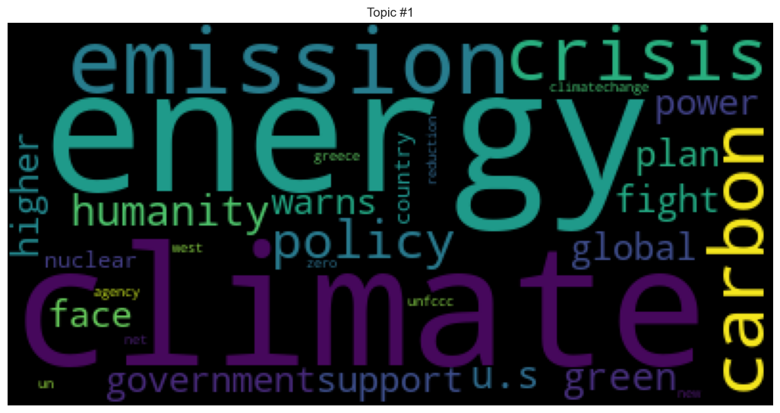
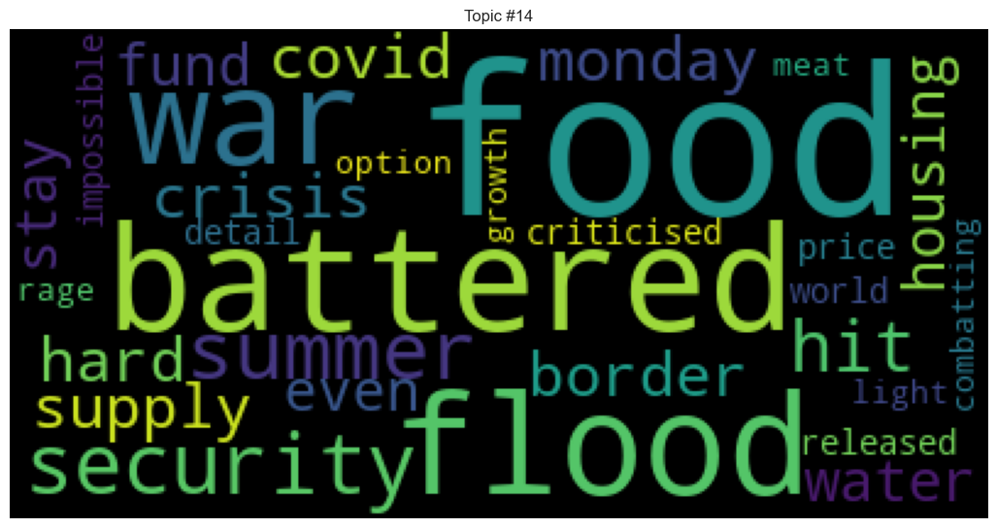
Analysis: Topic Modeling
Topic modeling is a technique that automatically identifies and groups main themes or topics within large volumes of text
Climate Policy and Implications
Food Security Amid Disasters
Topic 1: Climate Policy and Implications
discourse around climate crisis and the policies needed to address it
regional or global environmental policies.
Topic 2: Food Security Amid Disasters
food security in times of floods, wars, and other disasters
challenges faced during summer or other critical times.
Notes:
Topic modeling is a technique used to automatically identify topics present in a text corpus by analyzing the patterns of word co-occurrence. Representing two topics I identified in the corpus. Python word cloud visually represents text data by displaying the most frequently occurring words in larger sizes and bolder colors.
Energy Sources and Their Impact:
Discussing the environmental impact of different energy sources.
Legal implications with energy companies.
Highlight: Advocacy against harmful energy practices and fossil fuels.
Technical & Policy Aspects:
Delving into carbon emissions and energy sources.
Discussing potential strategies and policies.
Highlight: Intersection of climate change with food and agriculture.

Slide 7

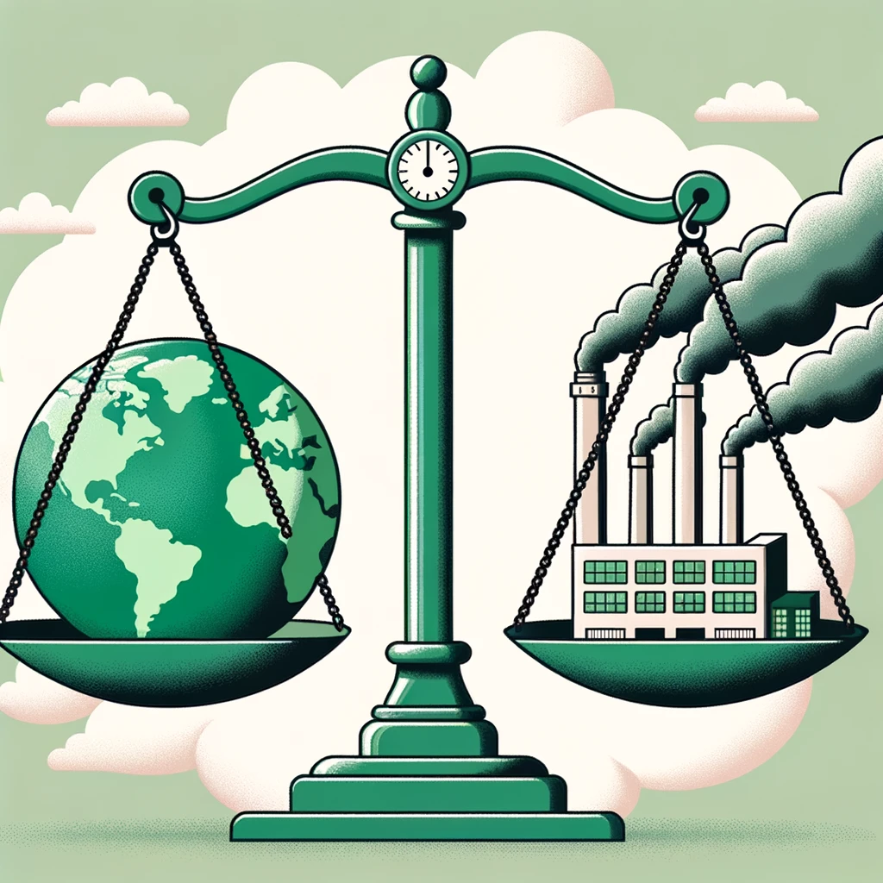
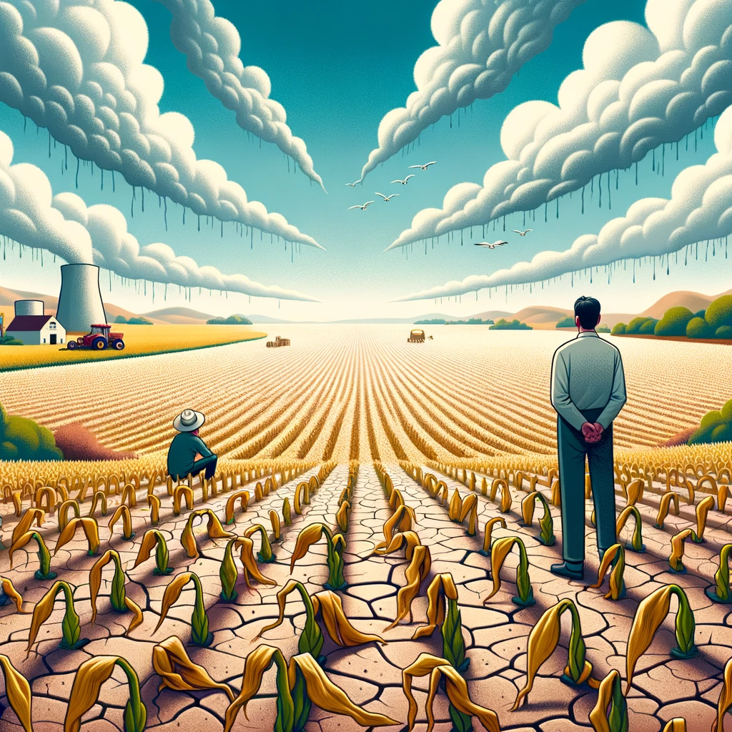
Takeaways
Word Frequency Analysis
Sense of urgency & need for immediate action
Solution-oriented discourse
Emotionally-charged debates
Named Entity Recognition
Politicized issue, especially in US
Media outlets shape narrative
Global issue with local impacts
Topic Modeling
Holistic Climate Discourse
Cross-Sectoral Resilience
Interplay of Policy and Community Action
Notes:
Takeaways:
- The climate change conversation on Twitter heavily references statements from various individuals, suggesting the influence of experts, politicians, and celebrities.
- Words like "people" and "world" showcase the global perspective of the discourse, emphasizing its collective nature.
- There's a clear sense of urgency, highlighted by terms like "action" and "crisis".
- Discussions seem to be multifaceted, covering the impact of climate change, the role of energy sources, and broader global implications.
- Two key topics emerged: one focusing on the environmental effects of energy sources, including legal implications and advocacy, and another exploring the technical and policy aspects, particularly the nexus of climate change, food, and agriculture.
Pitch:
- Twitter's climate discourse reveals an urgent, global conversation influenced by a mix of experts, politicians, and public figures.
- It's not just about recognizing the problem, but actively discussing solutions, impacts, and policies.
- From the legal challenges posed by energy companies to the intersection of climate with food security, the depth and breadth of the conversation are undeniable.
- Our initial insights point to a rich tapestry of discussion, but there's so much more to uncover.
- Diving deeper will allow us to grasp these narratives fully and potentially steer the conversation towards tangible, hopeful solutions. Let's harness this opportunity to influence and inspire a brighter future.

